Slide 1



BHOJAN
Food Ordering System
Aakritee Chaulagain
BCIS VIII
20080001
Medhavi College

Slide 2


Introduction
Problem Statement
Objectives
Features
Methodology
Data Flow Diagram
Use Case
Technology
Expected Outcomes
Conclusion
TABLE OF CONTENT

Slide 3


INTRODUCTION
Bhojan offers a well designed and powerful application to help customer to make an online food order at any time where restaurant owner will get orders to grow up business.
Bhojan prioritizes user convenience and customization with multiple features, eliminating traditional food ordering hassles and embracing the future of gastronomic delight.

Slide 4
PROBLEM STATEMENT
Current food ordering systems suffer from inefficiencies leading to prolonged wait times, order inaccuracies, and dissatisfied customers.
Customers often face challenges finding personalized food options, leading to dissatisfaction and decreased user engagement.
The complexity of payment methods in food ordering systems often results in confusion and potential security risks for users.

Slide 5



Objectives
To provide a wide range of food options and menus for customers to choose from.
To optimize order management for restaurants, improving efficiency, reducing errors, and ensuring timely and accurate order fulfillment to meet customer expectations.

Slide 6
FEATURES
User authentication
Menu exploration
Order placement
Admin Login
Add to cart
Checkout
Search functionality
Responsive design
Email notification

Slide 7
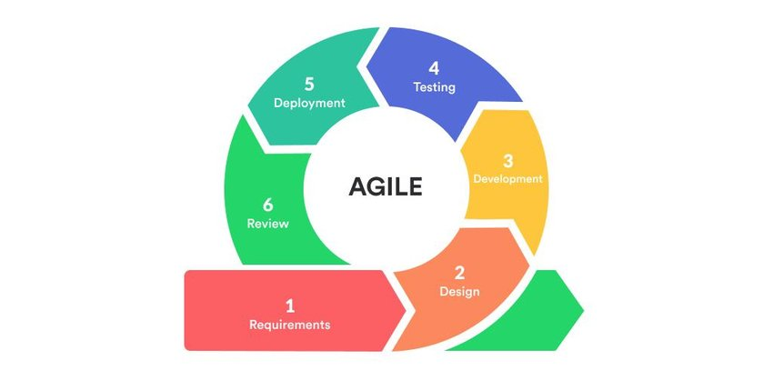
METHODOLOGY

Slide 8
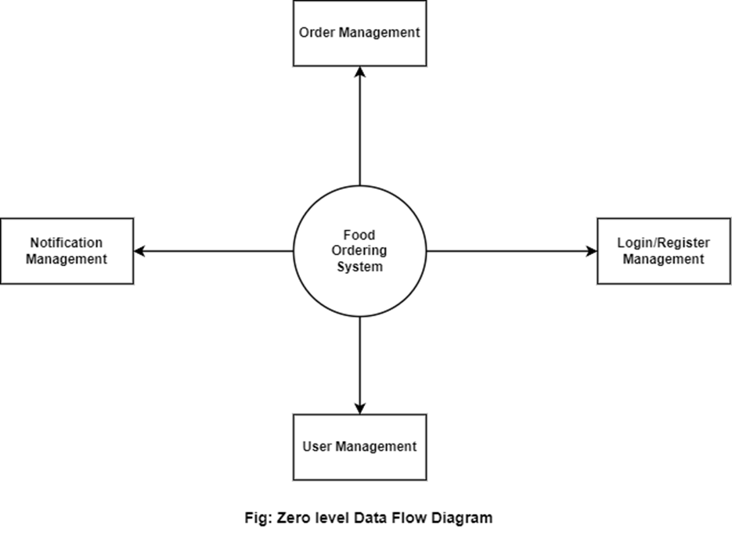
DATA FLOW DIAGRAM

Slide 9
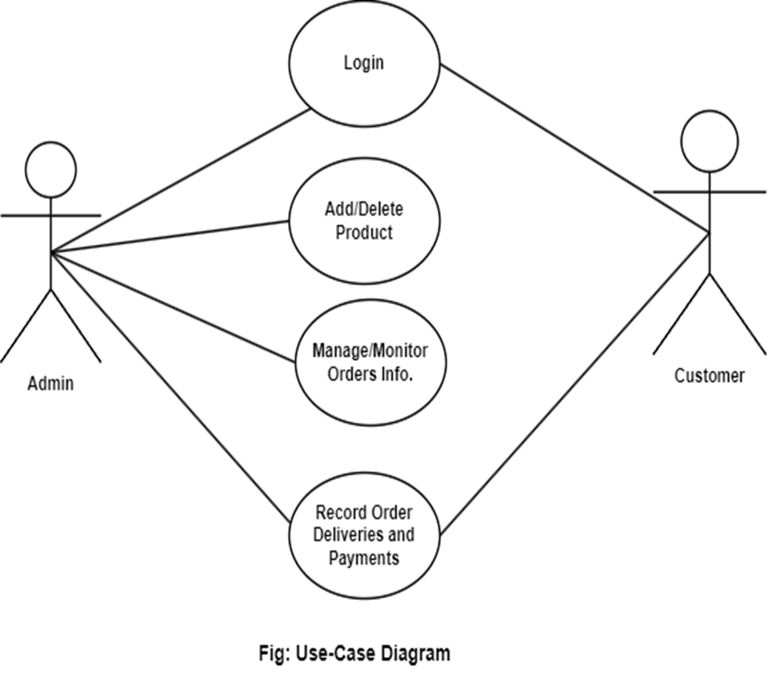
USE CASE

Slide 10
TECHNOLOGY
React
MongoDB
Next.js

Slide 11
EXPECTED OUTCOME
Enhanced User Experience
Increased Engagement and Retention
Diverse Culinary Exploration
Positive User Feedback and Reviews

Slide 12

The Bhojan Food Ordering App offers a seamless and intuitive platform for users to order their favorite meals.
With features like menu browsing, item selection and secure checkout, customers can easily navigate the app to place and manage their orders.
The app provides registration and login options for users to access their profiles and order history.

Slide 13

THANK YOU

